Slide 1

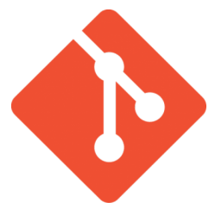

Git
About Git
Created by Linus Torvalds,
creator of Linux, in 2005
Came out of Linux development community
Designed to do version control on Linux kernel
Goals of Git:
Speed
Support for non-linear development (thousands of parallel branches)
Fully distributed
Able to handle large projects efficiently
(A "git" is a cranky old man. Linus meant himself.)
Java Full Stack Program

Slide 2
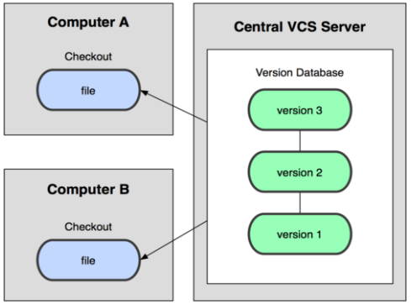
Centralized VCS
In Subversion, CVS, Perforce, etc. A central server repository (repo) holds the "official copy" of the code
the server maintains the sole version history of the repo
You make "checkouts" of it to your local copy
you make local modifications
your changes are not versioned
When you're done, you "check in" back to the server
your check in increments the repo's version

Slide 3
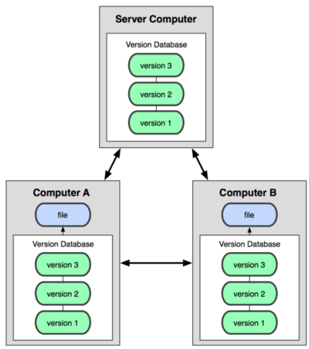
Distributed VCS (Git)
In git, mercurial, etc., you don't "checkout"
from a central repo
you "clone" it and "pull" changes from it
Your local repo is a complete copy of
everything on the remote server
yours is "just as good" as theirs
Many operations are local:
check in/out from local repo
commit changes to local repo
local repo keeps version history
When you're ready, you can "push"
changes back to server

Slide 4
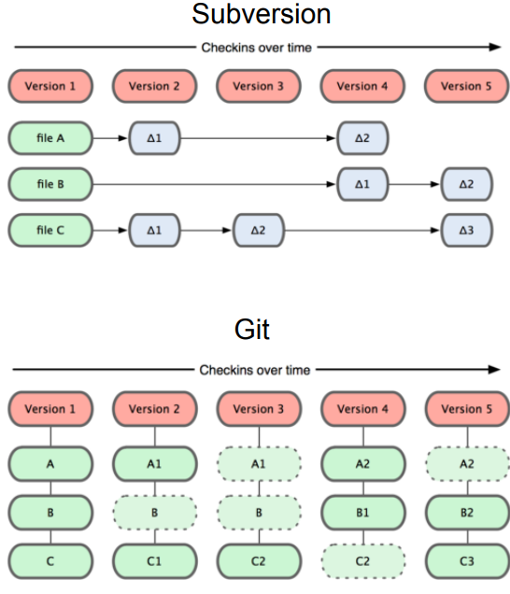
Git snapshots
Centralized VCS like Subversion
track version data on each individual file.
Git keeps "snapshots" of the entire
state of the project.
Each check in version of the overall
code has a copy of each file in it.
Some files change on a given
check in, some do not.
More redundancy, but faster.

Slide 5
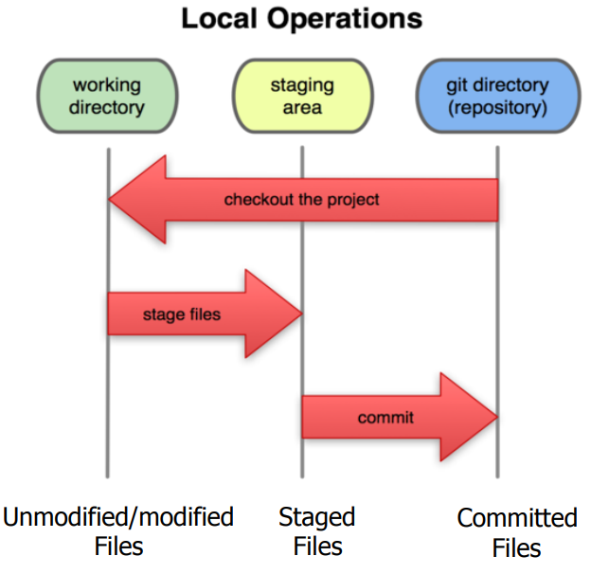
Local git areas
In your local copy on git, files can be:
In your local repo
(committed)
Checked out and modified,
but not yet committed
(working copy)
Or, in-between, in a "staging" area
Staged files are ready to be committed.
A commit saves a snapshot of all staged state.

Slide 6
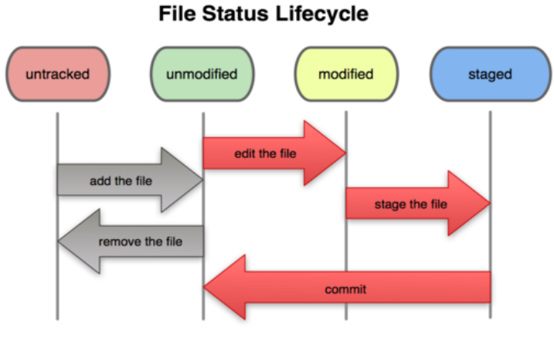
Basic Git workflow
Modify files in your working directory.
Stage files, adding snapshots of them to your staging area.
Commit, which takes the files in the staging area and stores that snapshot permanently to your Git directory.

Slide 7
Git commit checksums
In Subversion each modification to the central repo increments the version # of the overall repo.
In Git, each user has their own copy of the repo, and commits changes to their local copy of the repo before pushing to the central server.
So Git generates a unique SHA-1 hash (40 character string of hex digits) for every commit.
Refers to commits by this ID rather than a version number.
Often we only see the first 7 characters:
1677b2d Edited first line of readme
258efa7 Added line to readme
0e52da7 Initial commit

Slide 8
Initial Git configuration
Set the name and email for Git to use when you commit:
git config --global user.name "Bugs Bunny"
git config --global user.email bugs@gmail.com
You can call git config –list to verify these are set.
Set the editor that is used for writing commit messages:
git config --global core.editor nano
(it is vim by default)

Slide 9
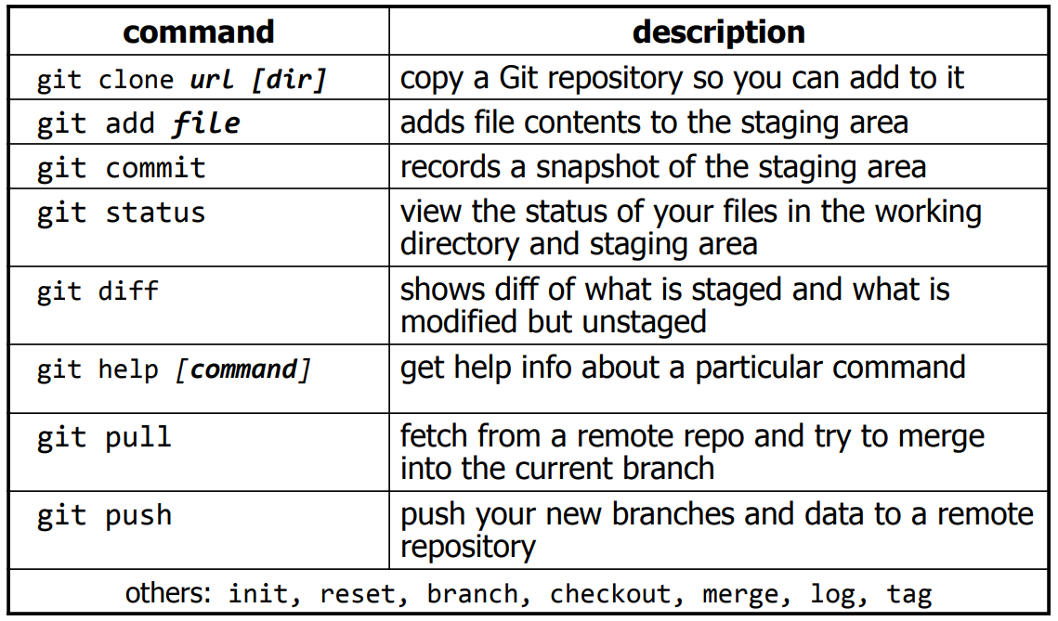
Git commands

Slide 10
Add and commit a file
The first time we ask a file to be tracked, and every time before we commit a file, we must add it to the staging area:
git add Hello.java Goodbye.java
Takes a snapshot of these files, adds them to the staging area.
In older VCS, "add" means "start tracking this file." In Git, "add" means "add to staging area" so it will be part of the next commit.
To move staged changes into the repo, we commit:
git commit –m "Fixing bug #22"
To undo changes on a file before you have committed it:
git reset HEAD -- filename (unstages the file)
git checkout -- filename (undoes your changes)
All these commands are acting on your local version of repo.

Slide 11
Viewing/undoing changes
To view status of files in working directory and staging area:
git status or git status –s (short version)
To see what is modified but unstaged:
git diff
To see a list of staged changes:
git diff --cached
To see a log of all changes in your local repo:
git log or git log --oneline (shorter version)
1677b2d Edited first line of readme
258efa7 Added line to readme
0e52da7 Initial commit
git log -5 (to show only the 5 most recent updates), etc.

Slide 12
An example workflow
[rea@attu1 superstar]$ emacs rea.txt
[rea@attu1 superstar]$ git status
no changes added to commit
(use "git add" and/or "git commit -a")
[rea@attu1 superstar]$ git status -s
M rea.txt
[rea@attu1 superstar]$ git diff
diff --git a/rea.txt b/rea.txt
[rea@attu1 superstar]$ git add rea.txt
[rea@attu1 superstar]$ git status
# modified: rea.txt
[rea@attu1 superstar]$ git diff --cached
diff --git a/rea.txt b/rea.txt
[rea@attu1 superstar]$ git commit -m "Created new text file"

Slide 13
Branching and merging
Git uses branching heavily to switch between multiple tasks.
To create a new local branch:
git branch name
To list all local branches: (* = current branch)
git branch
To switch to a given local branch:
git checkout branch name
To merge changes from a branch into the local master:
git checkout master
git merge branch name

Slide 14
Interaction w/ remote repo
Push your local changes to the remote repo.
Pull from remote repo to get most recent changes.
(fix conflicts if necessary, add/commit them to your local repo)
To fetch the most recent updates from the remote repo into your local repo, and put them into your working directory:
git pull origin master
To put your changes from your local repo in the remote repo:
git push origin master

Slide 15
BitBucket
What is BitBucket?
Bitbucket is a web-based version control repository hosting service that is primarily used for source code management.
It was created by Atlassian, the same company that created popular software development tools like Jira and Confluence.
Bitbucket allows developers to store their code in a central repository, manage code changes, collaborate with other developers, and deploy their code to various environments.
With Bitbucket, developers can create repositories for their projects and manage their code using Git or Mercurial version control systems.
They can also create branches for their code, work on multiple code changes simultaneously, and merge their changes back into the main branch.
Bitbucket also provides features such as pull requests, code reviews, and issue tracking, which make it easy for developers to collaborate on code and track issues and bugs.

Slide 16
Why developers use Bitbucket
Version Control:
Bitbucket provides a centralized repository for storing and managing code changes.
Developers can use Git or Mercurial version control systems to track changes, create branches, and merge code changes back into the main branch.
Collaboration:
Bitbucket provides features such as pull requests and code reviews, which make it easy for developers to collaborate on code changes.
Developers can provide feedback, suggest improvements, and resolve issues in a centralized platform.
Integration:
Bitbucket integrates well with other development tools like Jira, Confluence, and popular IDEs like Eclipse and IntelliJ IDEA.
This integration makes it easy for developers to manage their code changes and collaborate with other team members directly from their preferred development environments.

Slide 17
4. Security:
Bitbucket provides robust security features, including access controls, two-factor authentication, and encryption, which helps keep code and project data safe and secure.
5. Automation:
Bitbucket Pipelines provides built-in support for continuous integration and deployment (CI/CD) which helps automate build, test, and deployment processes.
This automation helps teams to save time and reduce errors, leading to faster releases and better quality software.

Slide 18
Overview of Bitbucket's features
Git Repository Hosting: Bitbucket provides Git repository hosting with unlimited private repositories for small teams, allowing them to store and manage code securely in the cloud.
Pull Requests: Bitbucket makes it easy for developers to collaborate by providing pull requests, allowing them to review, discuss and merge code changes seamlessly.
Code Reviews: Bitbucket's code review tools help developers to collaborate and catch errors early in the development cycle, reducing the risk of introducing bugs or security vulnerabilities.
Branch Permissions: Bitbucket allows teams to set branch permissions to control who can merge code and what changes can be made to specific branches, ensuring that the codebase is always kept secure and stable.

Slide 19
5.Continuous Integration and Deployment (CI/CD): Bitbucket integrates with a wide range of continuous integration and deployment (CI/CD) tools such as Bamboo, Jenkins, and Travis CI, allowing teams to automate their build, test, and deployment processes.
6.Issue Tracking: Bitbucket's issue tracking system enables teams to track bugs, tasks, and other issues, making it easy to prioritize and manage work items.
7.Wikis and Documentation: Bitbucket provides wikis and documentation tools to help teams keep track of project information, specifications, and other important documentation.
8.Integrations: Bitbucket integrates with a range of third-party tools such as JIRA, Trello, Slack, and HipChat, making it easy to connect and collaborate with other tools and teams.

Slide 20
Creating a Bitbucket Repository
Sign in to your Bitbucket account and navigate to the dashboard.
Click the "+" button in the left sidebar, then select "Repository" from the dropdown menu.
Select the type of repository you want to create. You can choose between Git, Mercurial, and other repository types.
Choose whether you want to create a new project or add the repository to an existing project. Projects are used to group related repositories together.
Enter a name for your repository and choose whether you want it to be public or private.
Add an optional description for your repository to help other users understand what it's for.
Choose the language that your repository is written in. This is used to help categorize your repository on Bitbucket.
Click the "Create Repository" button to create your new repository.

Slide 21
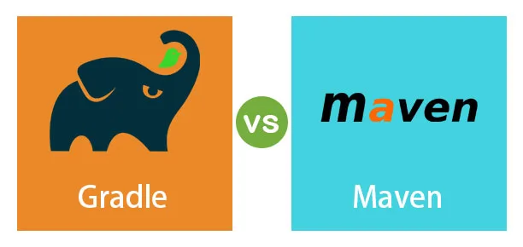
Gradle
What is Gradle?
Gradle is a powerful open-source build automation tool that is used primarily for building, testing, and deploying software applications.
It was first released in 2007 and has since
become a popular choice among software development
teams due to its flexibility, efficiency, and ease of use.
Gradle is based on a domain-specific language (DSL) that allows developers to describe the build process in a concise and readable way.
It supports multiple programming languages, including Java, Kotlin, Groovy, and C++, and can be used for a wide range of projects, from small applications to large enterprise systems.

Slide 22
Some of the key features of Gradle include:
Declarative build scripts: Gradle uses a DSL called Groovy to write build scripts that are easy to read and maintain.
Incremental builds: Gradle only builds what is necessary, saving time and reducing build times.
Dependency management: Gradle makes it easy to manage dependencies and libraries, including transitive dependencies.
Task-oriented: Gradle organizes build logic into tasks, which can be customized and combined to create complex build workflows.
Plugin architecture: Gradle has a flexible plugin architecture that allows developers to extend and customize the build process for specific needs.
Cross-platform support: Gradle runs on multiple platforms, including Windows, macOS, and Linux, and can be integrated with other tools and technologies.

Slide 23
Gradle Comparison with other build tools (e.g. Maven, Ant)
Here is a comparison of Gradle with Maven and Ant:
Build file syntax:
Gradle uses a domain-specific language (DSL) based on Groovy, which makes the build files more concise and expressive than Maven's XML and Ant’s XML or scripting language.
Build performance:
builds and caching mechanisGradle is known for its high performance due to its incremental m, which means it only builds what has changed since the last build. This makes Gradle faster than Maven and Ant for large and complex projects.
Maven and Ant require more memory and processing power for each build, which can cause longer build times.

Slide 24
Dependency management:
Gradle has a flexible and powerful dependency management system that allows for easier customization, transitive dependency management, and version conflict resolution. This is superior to Maven's dependency management system, which can be more rigid and complicated.
Ant does not have a built-in dependency management system, and developers need to manage dependencies manually.
Plugin ecosystem:
Gradle has a growing plugin ecosystem that is easy to use and customize. It also allows developers to write custom plugins with ease.
Maven has a mature plugin ecosystem, but it can be challenging to customize.
Ant has fewer plugins available, and developers need to write more code to achieve the same functionality.
Integration with IDEs and other tools:
Gradle has good integration with popular IDEs like Eclipse and IntelliJ IDEA, and other tools like Continuous Integration (CI) servers, making it easier to use in a developer's workflow.
Maven and Ant also have good integration with IDEs and CI servers.

Slide 25
Custom plugins and tasks in Gradle
Custom Plugins:
A Gradle plugin is a collection of tasks and configurations that can be applied to a Gradle project to extend its functionality.
To create a custom plugin, you can define a new class that extends the “Plugin” interface and overrides the “apply()” method.
Here's an example:
class MyCustomPlugin implements Plugin<Project> {
void apply(Project project) {
// Define tasks, configurations, and other functionality here
}
}
In this example, the apply() method defines the tasks, configurations, and other functionality that will be added to the Gradle project when the plugin is applied.

Slide 26
2. Custom Tasks:
A Gradle task is a unit of work that can be executed as part of the build process.
To create a custom task, you can define a new class that extends the DefaultTask class and implements the TaskAction interface.
Here's an example:
class MyCustomTask extends DefaultTask implements TaskAction{
Public void runTask(){
// Define tasks, configurations, and other functionality here
}
}
In this example, the runTask() method defines the functionality that will be executed when the task is run. You can also define inputs, outputs, and dependencies for the task.

Slide 27
3. Applying Custom Plugins:
To apply a custom plugin to a Gradle project, you can use the apply() method in the build script, like this:
apply plugin: 'com.example.myplugin'
In this example, the com.example.myplugin plugin will be applied to the Gradle project.
4.Running Custom Tasks:
To run a custom task, you can use the gradle command with the task name, like this:
gradle myCustomTask
In this example, the myCustomTask task will be executed as part of the build process.

Slide 28
Benefits of Gradle
Flexible and Highly Configurable:
Gradle is highly flexible and configurable, which means that it can be customized to meet the needs of a wide range of projects.
Gradle provides a powerful build scripting DSL that enables developers to express build logic in a concise and readable way.
This flexibility also allows Gradle to support a wide range of project structures and build workflows.
2.Dependency Management:
Gradle provides robust dependency management capabilities that simplify the process of managing dependencies for your project.
Gradle can resolve and download dependencies from a variety of sources, including Maven and Ivy repositories.
It also supports transitive dependency resolution, which means that it can automatically resolve dependencies that your project depends on.
3.Incremental Builds:
Gradle supports incremental builds, which means that it can intelligently determine which parts of a project have changed since the last build and only rebuild those parts.
This feature can significantly reduce build times for large projects, as Gradle can skip rebuilding unchanged parts of the project.

Slide 29
4.Multi-Project Builds:
Gradle provides robust support for multi-project builds, which makes it easier to manage complex projects with many sub-projects.
Gradle can manage dependencies, configurations, and build scripts across multiple projects, and it provides features like composite builds and parallel builds that make it easier to work with large projects.
5.Integration with IDEs:
Gradle integrates well with popular IDEs like Eclipse and IntelliJ IDEA, making it easier to manage builds and dependencies from within the IDE.
Gradle also provides plugins for popular development frameworks like Spring and Android, which can further simplify the development process.
6.Community Support:
Gradle has a large and active community of developers who contribute to the development of the tool and provide support to users.
This community provides a wealth of knowledge, resources, and plugins that can help developers get the most out of Gradle.

Slide 30
THANK YOU

